Slide 1
Interaction -Sequence Diagram

Slide 2
Interaction diagram – An interaction diagram is used to show the interactive behavior of a system. Since visualizing the interactions in a system can be a cumbersome task, we use different types of interaction diagrams to capture various features and aspects of interaction in a system.

Slide 3
Sequence Diagrams – A sequence diagram simply depicts interaction between objects in a sequential order i.e. the order in which these interactions take place. We can also use the terms event diagrams or event scenarios to refer to a sequence diagram. Sequence diagrams describe how and in what order the objects in a system function. These diagrams are widely used by businessmen and software developers to document and understand requirements for new and existing systems.

Slide 4
Sequence Diagram Notations –
Actors – An actor in a UML diagram represents a type of role where it interacts with the system and its objects. It is important to note here that an actor is always outside the scope of the system we aim to model using the UML diagram.

Slide 5
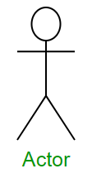
We use actors to depict various roles including human users and other external subjects. We represent an actor in a UML diagram using a stick person notation. We can have multiple actors in a sequence diagram.

Slide 6
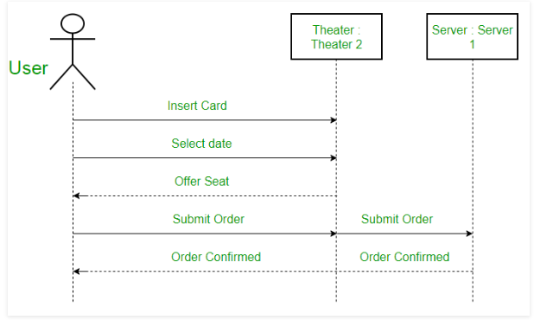
seat reservation system

Slide 7
For example – Here the user in seat reservation system is shown as an actor where it exists outside the system and is not a part of the system.

Slide 8
Lifelines
A lifeline is a named element which depicts an individual participant in a sequence diagram. So basically each instance in a sequence diagram is represented by a lifeline. Lifeline elements are located at the top in a sequence diagram. The standard in UML for naming a lifeline follows the following format – Instance Name : Class Name

Slide 9
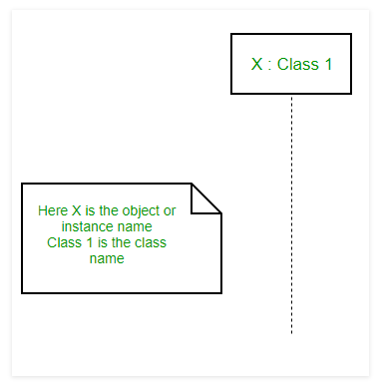

Slide 10
Difference between a lifeline and an actor – A lifeline always portrays an object internal to the system whereas actors are used to depict objects external to the system.

Slide 11
Messages – Communication between objects is depicted using messages. The messages appear in a sequential order on the lifeline. We represent messages using arrows. Lifelines and messages form the core of a sequence diagram.

Slide 12
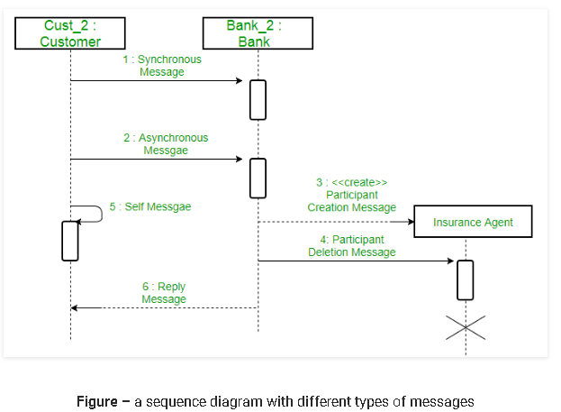
Messages can be broadly classified into the following categories :

Slide 13
Synchronous messages – A synchronous message waits for a reply before the interaction can move forward. The sender waits until the receiver has completed the processing of the message. The caller continues only when it knows that the receiver has processed the previous message i.e. it receives a reply message. A large number of calls in object oriented programming are synchronous. We use a solid arrow head to represent a synchronous message.

Slide 14
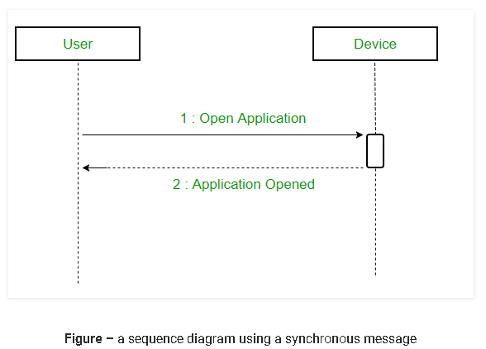

Slide 15
Asynchronous Messages – An asynchronous message does not wait for a reply from the receiver. The interaction moves forward irrespective of the receiver processing the previous message or not. We use a lined arrow head to represent an asynchronous message.

Slide 16
Create message – We use a Create message to instantiate a new object in the sequence diagram. There are situations when a particular message call requires the creation of an object. It is represented with a dotted arrow and create word labelled on it to specify that it is the create Message symbol. For example – The creation of a new order on a e-commerce website would require a new object of Order class to be created.

Slide 17
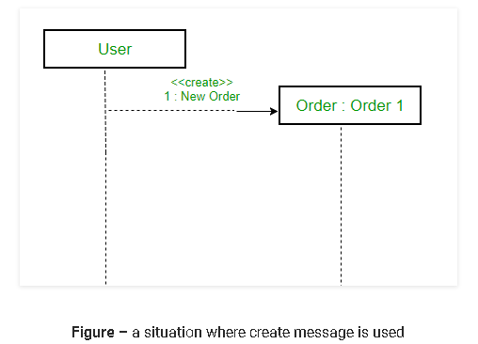

Slide 18
Delete Message – We use a Delete Message to delete an object. When an object is deallocated memory or is destroyed within the system we use the Delete Message symbol. It destroys the occurrence of the object in the system.It is represented by an arrow terminating with a x. For example – In the scenario below when the order is received by the user, the object of order class can be destroyed.

Slide 19
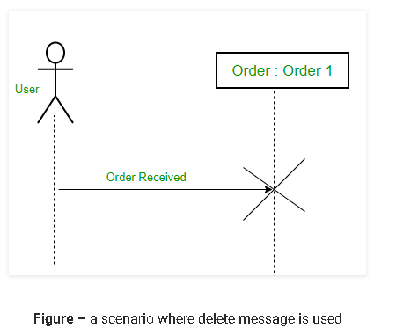

Slide 20
Self Message – Certain scenarios might arise where the object needs to send a message to itself. Such messages are called Self Messages and are represented with a U shaped arrow.

Slide 21
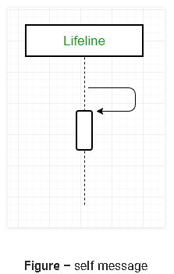

Slide 22
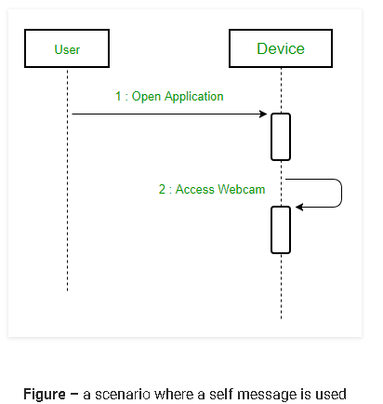
For example – Consider a scenario where the device wants to access its webcam. Such a scenario is represented using a self message.

Slide 23
Reply Message – Reply messages are used to show the message being sent from the receiver to the sender. We represent a return/reply message using an open arrowhead with a dotted line. The interaction moves forward only when a reply message is sent by the receiver.

Slide 24
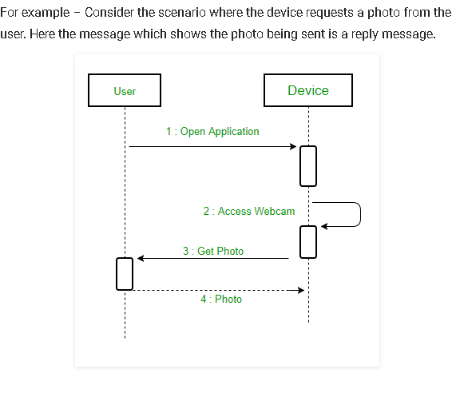

Slide 25
Found Message – A Found message is used to represent a scenario where an unknown source sends the message. It is represented using an arrow directed towards a lifeline from an end point. For example: Consider the scenario of a hardware failure.

Slide 26
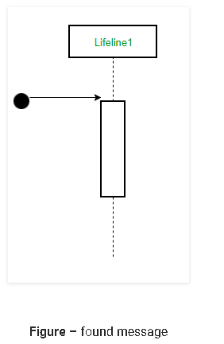

Slide 27
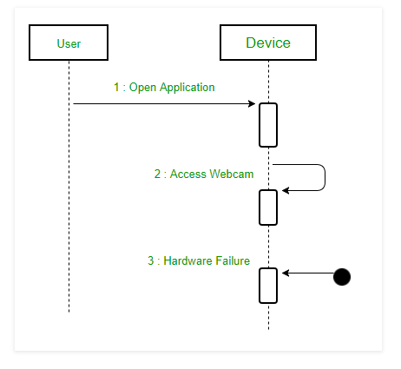
It can be due to multiple reasons and we are not certain as to what caused the hardware failure.

Slide 28
Lost Message – A Lost message is used to represent a scenario where the recipient is not known to the system. It is represented using an arrow directed towards an end point from a lifeline. For example: Consider a scenario where a warning is generated.

Slide 29
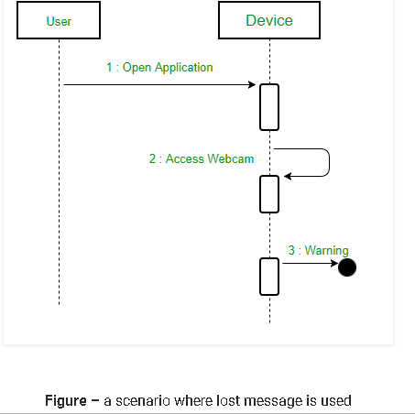

Slide 30
Guards – To model conditions we use guards in UML. They are used when we need to restrict the flow of messages on the pretext of a condition being met. Guards play an important role in letting software developers know the constraints attached to a system or a particular process.

Slide 31
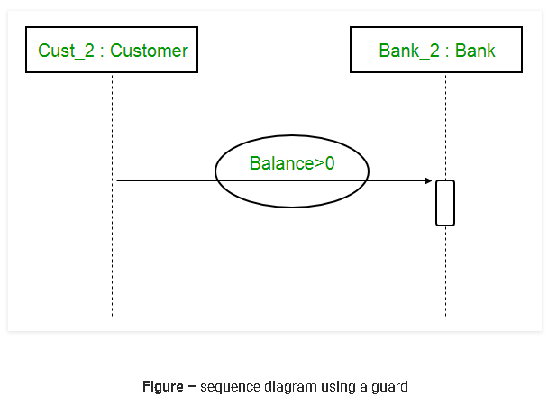
For example: In order to be able to withdraw cash, having a balance greater than zero is a condition that must be met as shown below.

Slide 32
A sequence diagram for an emotion based music player

Slide 33
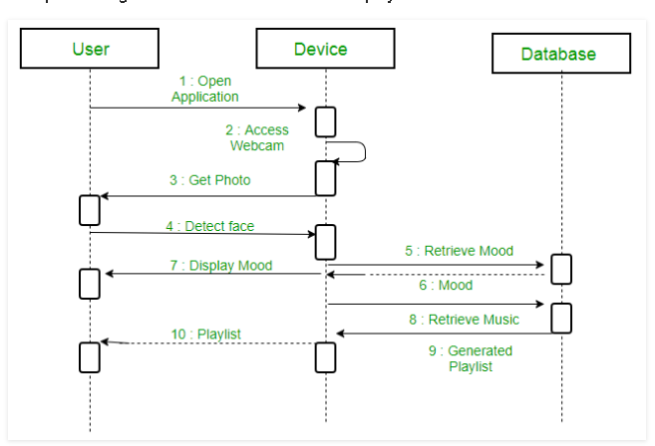

Slide 34
The above sequence diagram depicts the sequence diagram for an emotion based music player:

Slide 35
Firstly the application is opened by the user.
The device then gets access to the web cam.
The webcam captures the image of the user.
The device uses algorithms to detect the face and predict the mood.
It then requests database for dictionary of possible moods.
The mood is retrieved from the database.
The mood is displayed to the user.
The music is requested from the database.
The playlist is generated and finally shown to the user.

Slide 36
Uses of sequence diagrams –
Used to model and visualise the logic behind a sophisticated function, operation or procedure.
They are also used to show details of UML use case diagrams.
Used to understand the detailed functionality of current or future systems.
Visualise how messages and tasks move between objects or components in a system.

